Slide 1

Fading led
Objective:
Learn to use analogWrite() function in Arduino IDE.

Slide 2
analogWrite() function
Writes an analog value to a pin
Analog value range from 0 to 255
The function work on the following pins 3,5,6,9,10 and 11
Syntax : analogWrite(pin, value);
Example:
analogWrite(9,200);

Slide 3
Components required
Arduino UNO
Breadboard
Jumper Wires
LED
Resistor 220 OHM

Slide 4

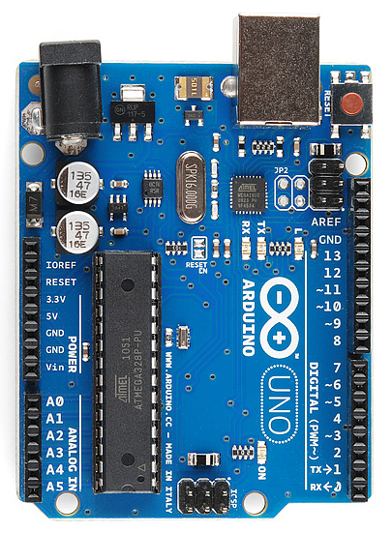
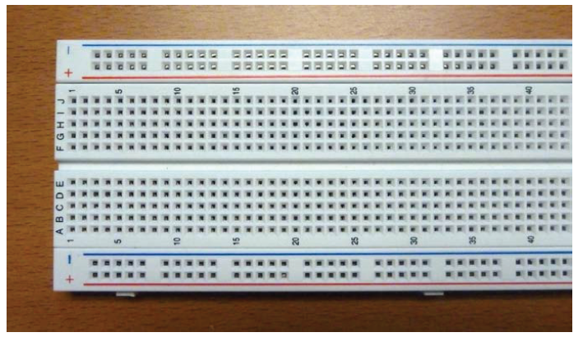
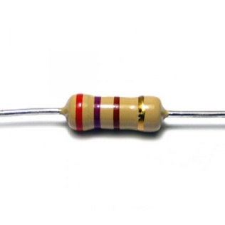
Connection diagram

Slide 5

Its coding time……

Slide 6
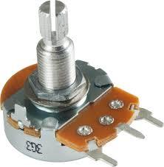
Control led brightness using potentiometer
Objective:
Learn to use the analogRead() function In Arduino IDE

Slide 7
analogRead() function
Read an analog value from different analog sensors
Its value range from 0 to 1023
The function work on the following pins
A0 , A1 , A2 , A3 , A4 and A5
Syntax : analogRead(analogpin);
Example:
analogRead(A0);

Slide 8
Components required
Arduino Uno
Breadboard
Potentiometer
Led
Jumper wire

Slide 9
Potentiometer contd……
A potentiometer is a three-terminal resistor with a sliding
or rotating contact that forms an adjustable voltage divider.
Potentiometers are commonly used to control electrical
devices such as volume controls on audio equipment , controlling a Fan using regulator.

Slide 10
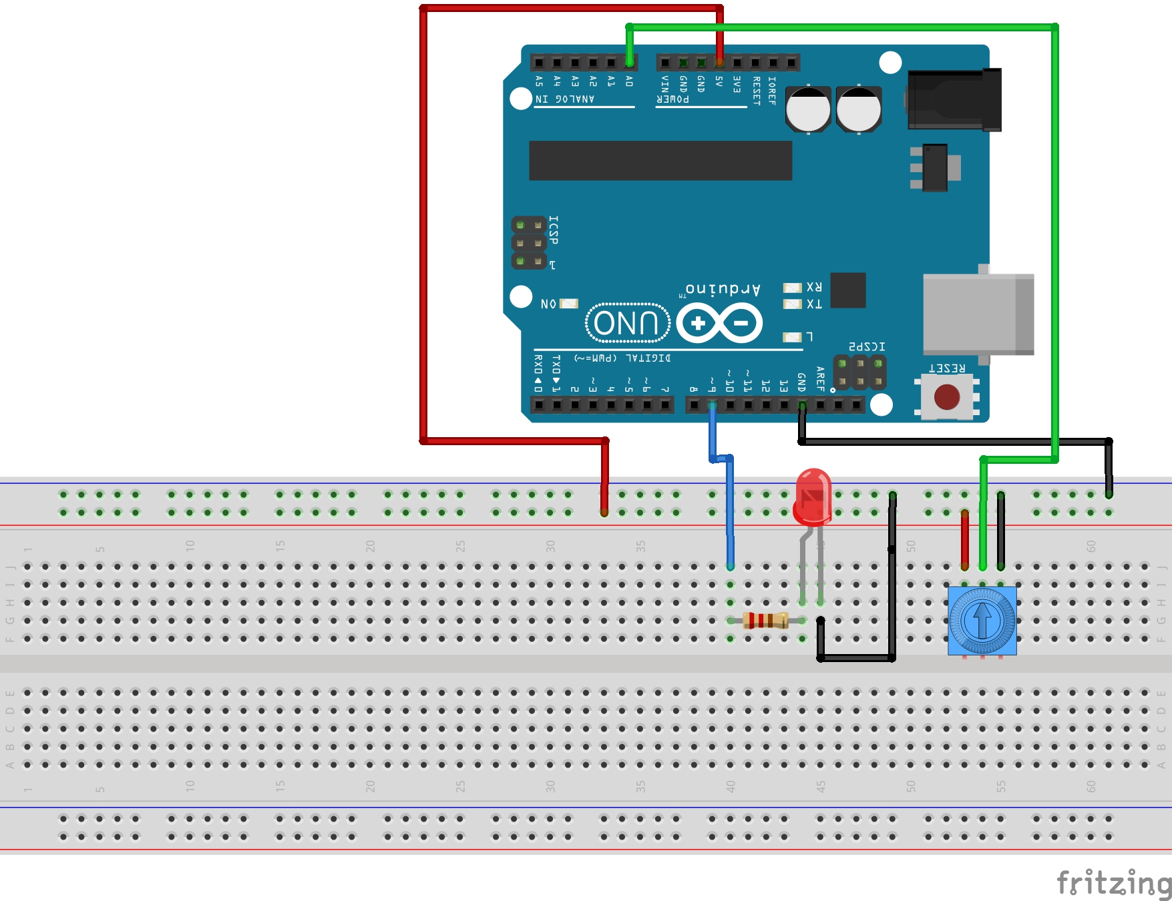
Connection diagram

Slide 11
Its coding time……

Slide 12
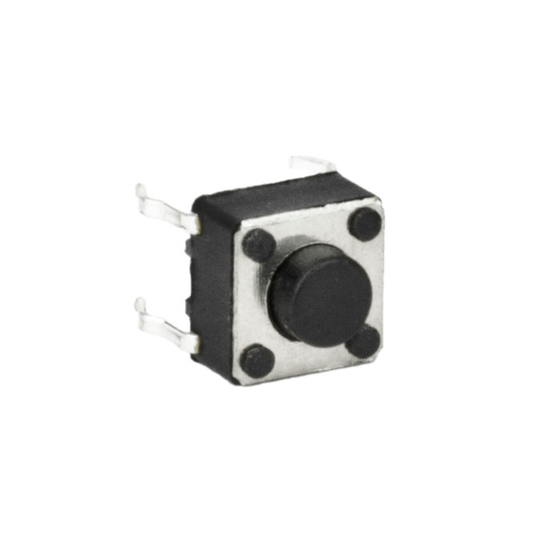
pushbutton
Pushbutton is a simple switch
It is uses in keypad , calculators ,push-button telephones

Slide 13
components required
Arduino Uno
Pushbutton
LED
Resistor 350 Ω
Breadboard

Slide 14
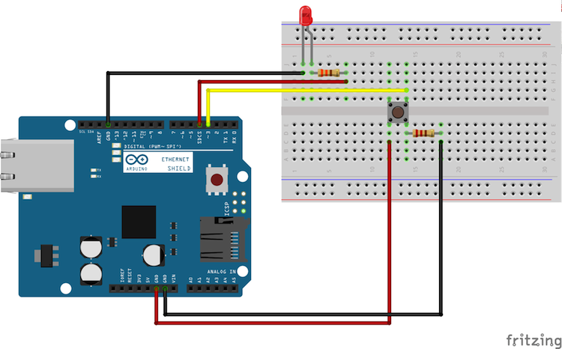
Connections diagram
220Ω
10k Ω

Slide 15
Its coding time……

Slide 16
Thank you

